Slide 1
Porter’s Five Forces Model
Abid Anwar
Jamaica Bardney-Visscher
Ijeoma Odoko
Neha Talwar

Slide 2
Agenda
Summary of Methodology
Classification of Forces
Advantages
Limitations
Case Study

Slide 3
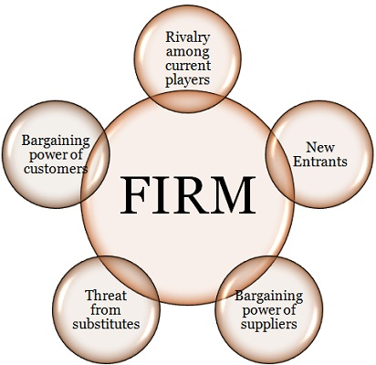
Summary
Developer: Michael E. Porter
Date: 1979
Origin:
1979 book called "Competitive Strategy: Techniques for Analyzing Industries and Competitors"
An analysis tool that uses five industry forces to determine the intensity of competition in an industry and its profitability level

Slide 4

1. Bargaining power of customers (buyers)
Definition:
Examines the power of the consumer and their effect on pricing and quality
Strong customer power can make industry more competitive and decrease profit potential
Lower profits when customer bargaining power is higher

Slide 5
Factors that influence customer bargaining power
Differentiation of products
Customer information availability
Seller's switching costs
Customer price sensitivity
Discretionary vs. Staple
Power of distribution channels

Slide 6

2. Bargaining Power of Suppliers
Definition:
Analyzes how much power a supplier has and how much control it has over the raising of its prices.
Company's profit margin is affected when suppliers are powerful
Also companies are affected when suppliers sell directly to customers as well as to another company

Slide 7
Factors that influence supplier bargaining power
Customer switching barriers
Patent and industry standards
Brand equity
Limited competition
Supplier vs buyer concentration
Loyalty programs
After sales features such as warranties and upgrades

Slide 8

3. Threat of new entrants
Definition:
Determines the difficulty to enter a particular industry
Great success attracts competition which erodes profitability
An influx of supply occurs when capacity increases with new entrants thus affecting prices

Slide 9
Factors that influence the probability of new entrants
Barriers to entry
Economies of scale
Industry profitability
Government policy
Access to resources, distribution channels, and key suppliers

Slide 10

4. Threat from substitutes
Definition:
The ability for customers to switch from one product to another with little cost in response to price changes
It is not about the products/services being the exact same, it is about the products/services satisfying the same basic or economic need
The threat of substitutes could come from a different industry
Notes:
1 –9 : Jamaica
10 – 15 : Abid
product substitution from new technologies is more convenient;
the need for the product may be replaced by meeting a different need;
it is possible to decide to ‘do without it’!

Slide 11
Factors that influence the threat of substitutes
Discretionary vs staples
Product differentiation
Customer's switching costs
Price-performance comparison
Availability of substitute products

Slide 12

5. Rivalry among existing competitors
Definition:
Main driver is the number and capability of competitors in the market
It depends on the industry
Intense rivalry attracts customers due to practices of aggressive price cuts and marketing campaigns

Slide 13
Factors that influence the rivalry among existing competitors
High fixed costs
High exit barriers
Many competitors of similar size
Slow aggregate industry growth
Customer loyalty
Notes:
there are many competing firms;
buyers can easily switch from one firm to another;
the market is growing only slowly or not growing at all;
the industry has high fixed costs and responding to price pressure is difficult;
products are not well differentiated or are commoditised so there is little brand loyalty;
the costs of leaving the industry are high.

Slide 14

Why we use Porter's Framework?
It is simple to use and understand
It helps to identify key forces
affecting the business
Helps organizations understand the factors affecting profitability in a specific industry
It is used in the development of strategies
It increases the viability of new businesses
Measures the competitiveness of the market

Slide 15

Limitations of Porters Forces
Government is not treated
as a sixth force
International businesses has led to
more complex and collaborative
relationships
This model is difficult to apply to
non-profit organizations
Only serves as a starting point for more detailed analysis of company performance
Does not provide a mechanism for quantifying how each force and its factors affect company performance

Slide 16
Case Study: ABC's Survival and Competition through Global
Expansion
This study analyzes the ABC company as a case study for food industry in Fast-Moving Consumer Goods (FMCG) sector in Turkey.
About ABC
Established some 43 years ago.
Main activities are the
Domestic production
domestic and international marketing of various kinds of food.
Total production capacity is 169,400 tons / year.
30% of its total production exported to USA, European Countries, Japan, Australia, Middle East Countries and some African Countries.
Looking to expand their participation in foreign market.

Slide 17
Forces Driving Competition
FMCG refers to goods consumed daily or frequently and have a high return.
Intense Competition Driven Industry in a state of continuous change.
Globalization dominating world economies.
Drivers for international expansion.
Trade barriers are falling.
Saturation in local markets.
Attraction of being able to access international markets via import/export agents.

Slide 18
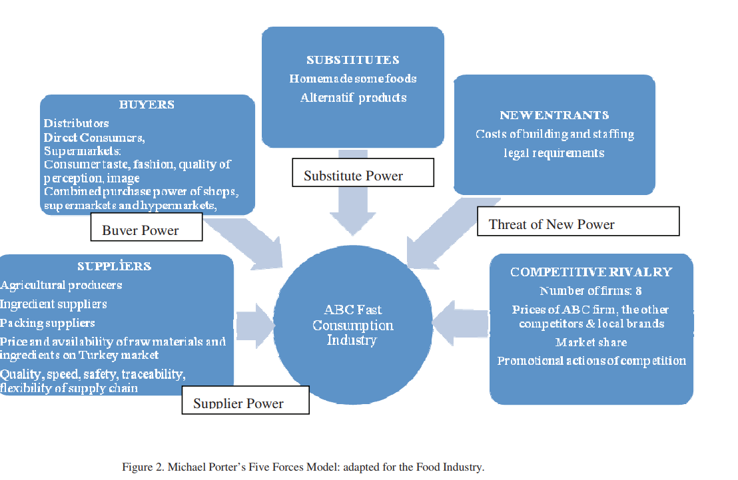
Porter's model adapted for ABC Food Industry

Slide 19
Purpose of using Porter's Model
Analyze the competitive environment of the food Industry.
Evaluate the five forces to determine the profit potential in the industry.
Find effective sources of competitive advantage.
Provide insight into both enterprise online and offline competitive environments.
Assess the globalization potential of the industry.

Slide 20
Porter's model adapted for ABC Food Industry

Slide 21
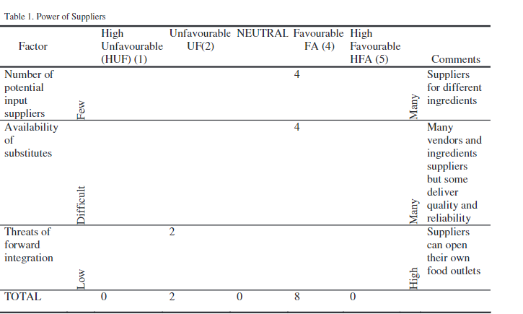
Power of Suppliers
Agricultural producers
Ingredient suppliers
Packing suppliers
Price and availability of raw materials and ingredients on Turkey market
Quality, speed, safety, traceability, flexibility of supply chain

Slide 22
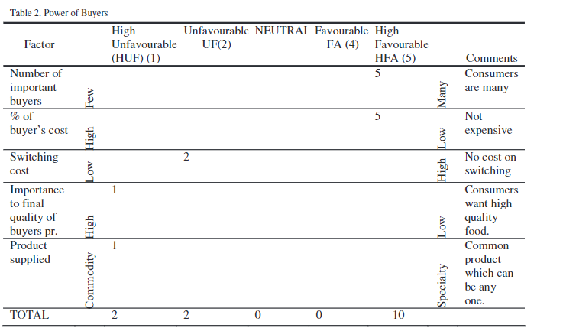
Power of Buyers
Distributors
Direct consumers, supermarkets
Consumer taste, fashion, quality of perception, image
Combined purchasing power of shops, supermarkets and hypermarkets

Slide 23
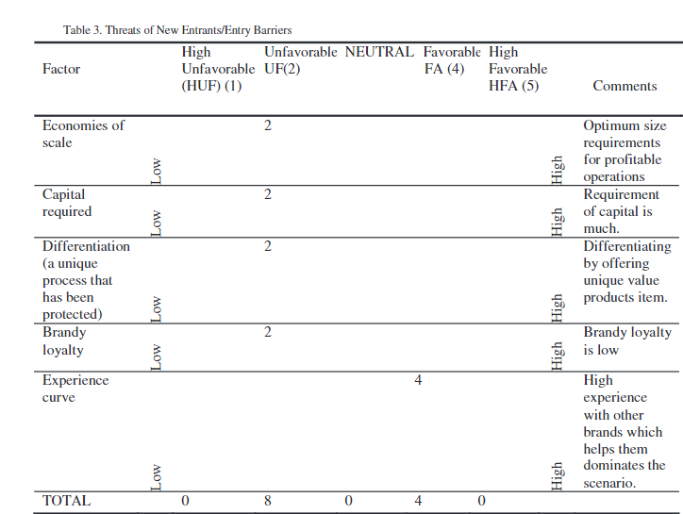
Threats of New Entrants
Costs of building and staffing
Legal requirements

Slide 24
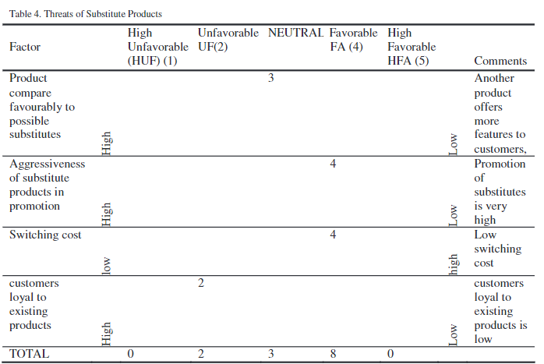
Threats of Substitute Products
Some homemade foods
Alternative products

Slide 25
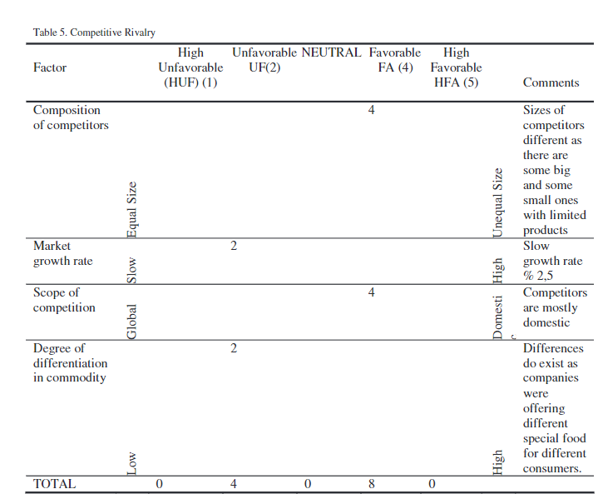
Competitive Rivalry
Number of firms
Prices of ABC form against the other competitors and local brands
Market share
Promotional actions of competition

Slide 26
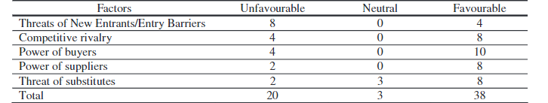
Measuring Metric : Competitiveness in market
The Firms’ Survival and Competition through Global Expansion: A Case Study from Food Industry in FMCG Sector

Slide 27
Conclusion: five forces analysis tool
For the case of food industry in FMCG sector implementation in Turkey, the competitive profit in the industry is low.
Strategies need to be proposed for better competition positioning for the industry.
globalization but for large companies – Think global act local
Smaller companies focus on local market requirements
Summary of Porter's Five Forces: to examine the profit potential in a particular industry( driven by market economics, environmental and competitive conditions)
Extensive research is required to apply findings directly to ABC.

Slide 28
References
Paul, D., Cadle, J., Yeates, D., Eva, M., & Hindle, K. (2017). Business analysis. Swindon: British Informatics Society Limited.
Oraman, Y., Azabagaoglu, M., & Inan, I. (2011). The Firms’ Survival and Competition through Global Expansion: A Case Study from Food Industry in FMCG Sector. Procedia - Social and Behavioral Sciences, 24, 188-197. doi:10.1016/j.sbspro.2011.09.021
Porter, M. E. (1980). How competitive forces shape strategy. McKinsey Quarterly, (2), 34–50. Retrieved from https://search.ebscohost.com/login.aspx?direct=true&db=bth&AN=6990575&site=eds-live&scope=site

